Slide 1
Program flow mechanism
Conventional machines (uses control flow mechanism) uses control flow mechanism in which order of program execution explicitly stated in user programs.
Dataflow machines (uses data driven mechanism) are based on a data-driven mechanism which allows the execution of any instruction to be driven by the operand availability.
Data flow computers supports high degree of parallelism at fine grain instruction level.
Reduction computers (Demand-driven mechanism) are based on demand driven
mechanism which initiates an operation based on the demand.

Slide 2

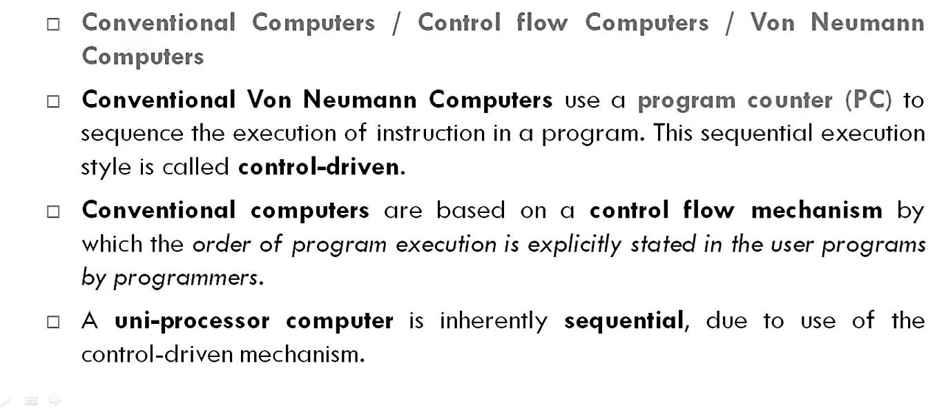










Control flow computers

Slide 3

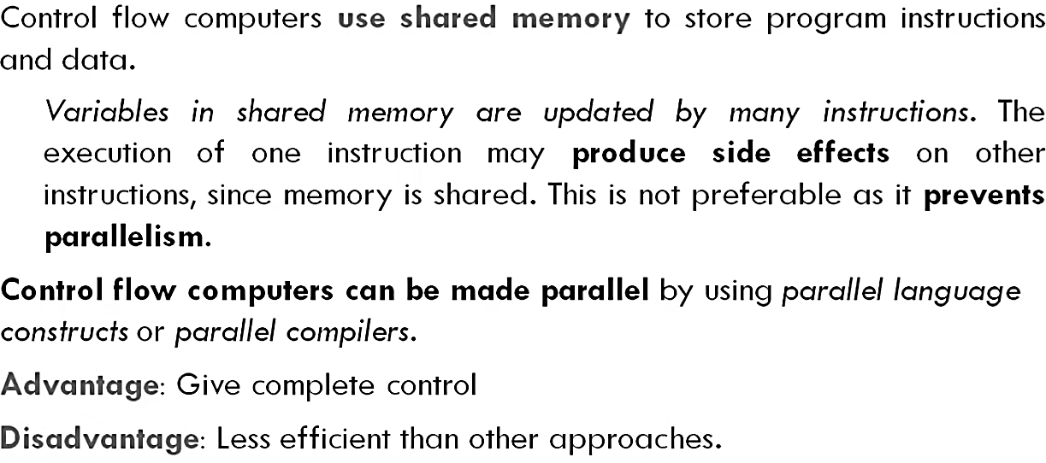

Slide 4
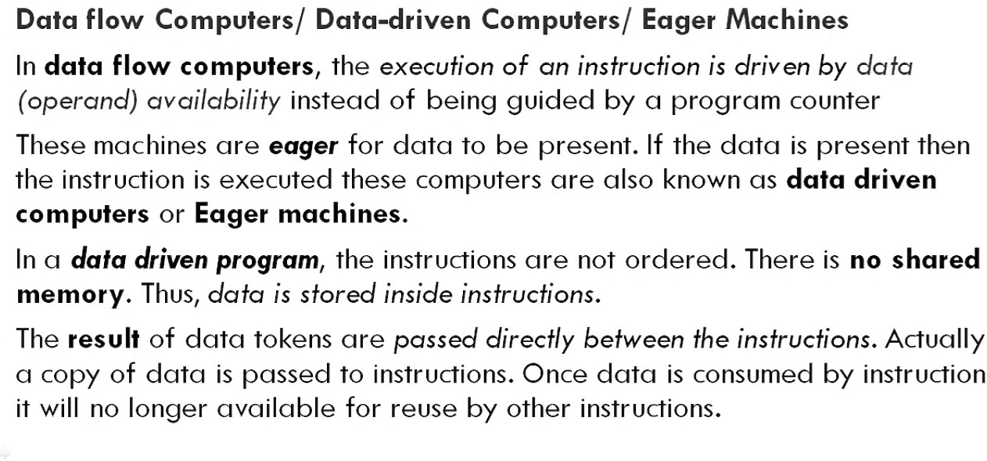
Data flow Computers

Slide 5
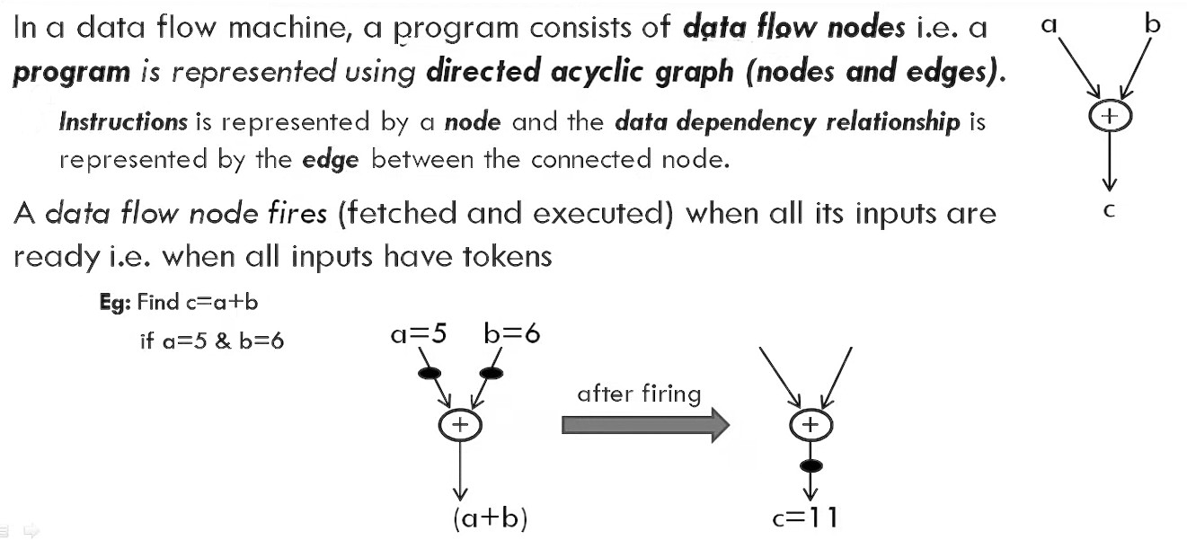

Slide 6
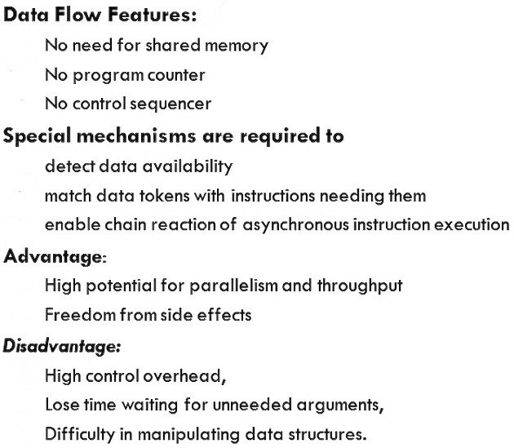

Slide 7
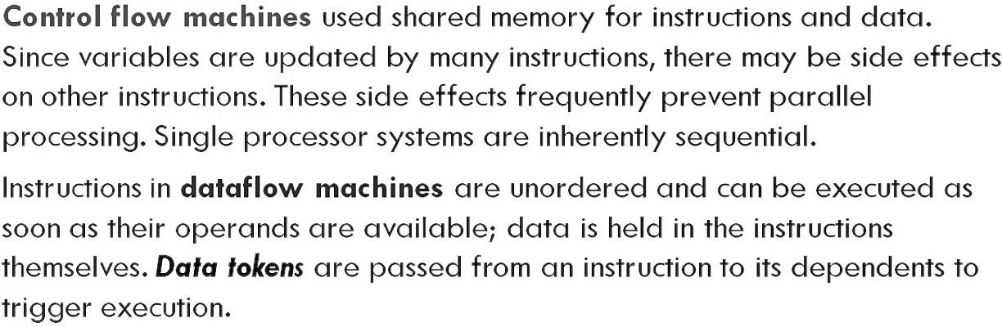
Control flow vs Data flow

Slide 8
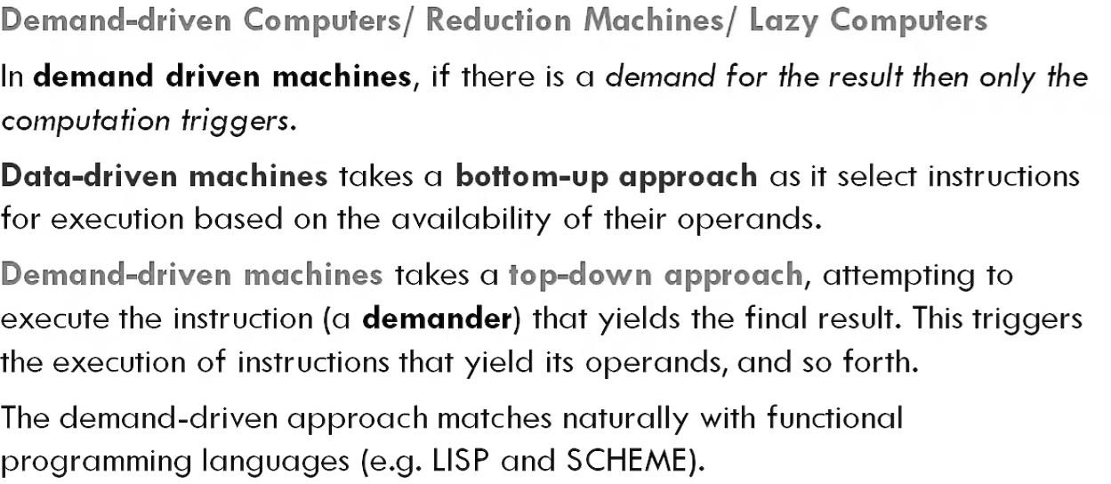
Demand Driven Computers

Slide 9
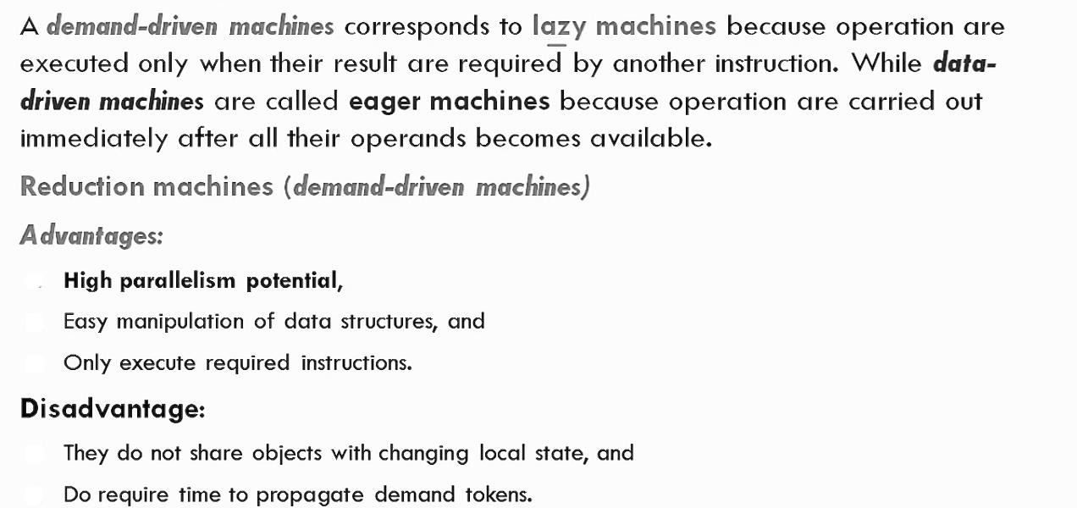

Slide 10
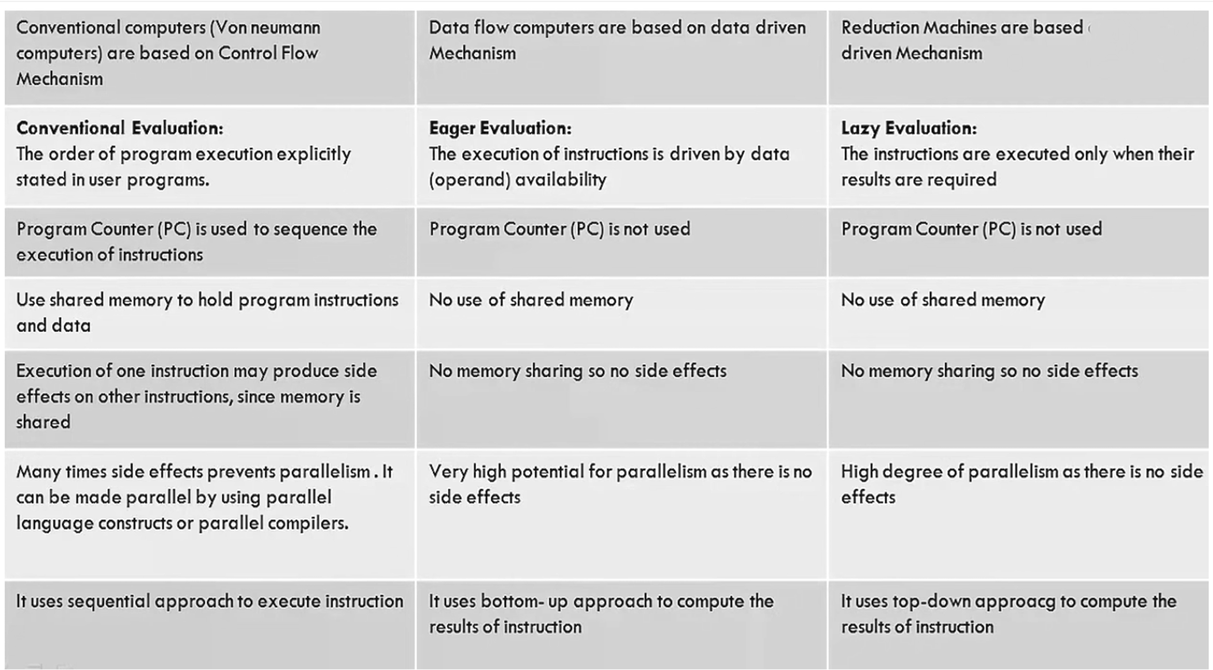
on demand

Slide 11
